Slide 1

Thriving in the New HHC Market
Presented to
ECRM HHC
by
Jack Evans
www.RetailHomeCare.com

Slide 2
Opting OUT of Medicare for Retail
Primary Care Physicians
9,539 Opted out in 2012
  3x as many as in 2010
Only 81% of PCP’s will accept new Medicare patients.
4% of PCP’s now are cash-only concierge practices.
HHC Providers
105,000 total before Accreditation
89,400 after Accreditation
Competitive Bidding & Audits
2,000 (?) Competitive Bid Winners remain
Venture Capital & Private Equity groups are funding retail HHC chains across the country.

Slide 3
Competitive Bidding Options - 1
(Assuming you did not win the bid!)
Grandfathered Supplier
  If provided HHC products & supplies prior to implementation of CB program
Subcontracting
  Directly with CB contractor
  For delivery, patient education, set-up, repair and maintenance, and obtaining documentation.

Slide 4
Competitive Bidding Options - 2
Baird’s 5% Rule
  A non-contract supplier can have its Provider Transaction Access Number (PTAN) added to a CB contract after:
    a contract supplier purchases 5% or more of the non-contract supplier;
    the non-contract supplier purchases 5% or more of a contract supplier; or
    a shared parent company or shared individual owner acquires 5% or more of both the contract supplier and the non-contract supplier.

Slide 5
New HHC Business Model
Government Reimbursement Decreases
  Entitlements phased out over a period of years
Private Pay Increases
  Need for HHC continues to grow
  Homecare insurance as hot seller
  HHC becomes cash commodity in a retail business
  Contracted & private pay opportunities grow:
    Hospice
    VA & TRICARE
    Prisons
    Workers’ Comp
    Self-insured Corporations
    Patient-Centered Medical Home (ACO’s)
    Hospital at Home (3rd Party Insurance)

Slide 6
Retail HHC Best Practices: Retail Showroom
Retail Location:
  Visible – Easy to find
  Accessible – Easy to drive into and park
  Convenient – Located near other retail shopping
  Co-Located – Close to other chain Rx ‘s
Average Showroom Size:
  Stand-alone HHC: 1,500 – 2,500 sq. ft.
  HHC/Rx: 800 – 1,000 sq. ft.

Slide 7
Retail HHC Best Practices: Revenue
Retail HHC w/ Medicare | Retail HHC w/o Medicare
20% - 40% Medi/Medi
10% - 35% Private Insurance | 20% - 50% Private Insurance/Medicaid/ Hospice
40% - 65% Retail (cash, credit card & check) | 60% - 90% Retail
Retail HHC Rx w/ Medicare | HHC Rx w/o Medicare
10% – 20% Medi/Medi
20% – 40% Private Insurance | 10% – 40% Private Insurance/Medicaid
50% – 70% Retail | 45% - 90% Retail

Slide 8
Retail HHC Best Practices:
Annual Gross Sales
Retail HHC w/Medicare
$1Mil - $1.5Mil average
Gross Sales/sq. ft./ year:
  400 sq. ft. Showroom = $200 - $300
  800 sq. ft. Showroom = $400 - $600
  1,500 sq. ft. Showroom = $800
Retail HHC w/o Medicare
$600,000 - $800,000 average
Gross Sales/sq. ft./year:
  400 sq. ft. Showroom = $100 - $150
  800 sq. ft. Showroom = $200 - $400
  1,500 sq. ft. Showroom = $400 - $600
  (vs. $20,000 - $30,000/gross sales/yr. for 12’ planogram!)
Rule of thumb in retail HHC: The more you display, the more you sell!

Slide 9
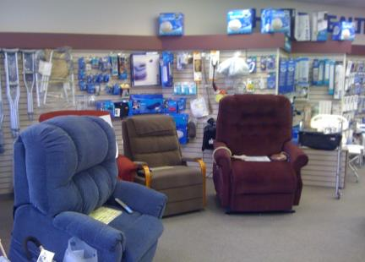
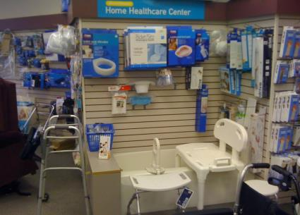
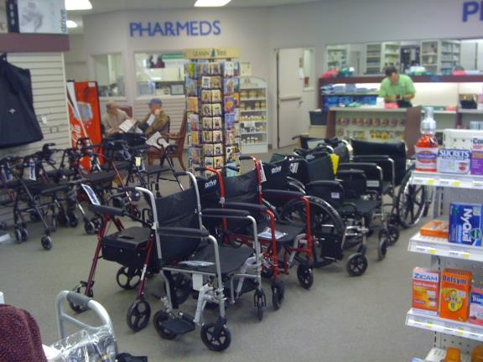
Minimum HCC Display
400 sq. ft. Floor
Display
Trained
Salesperson

Slide 10
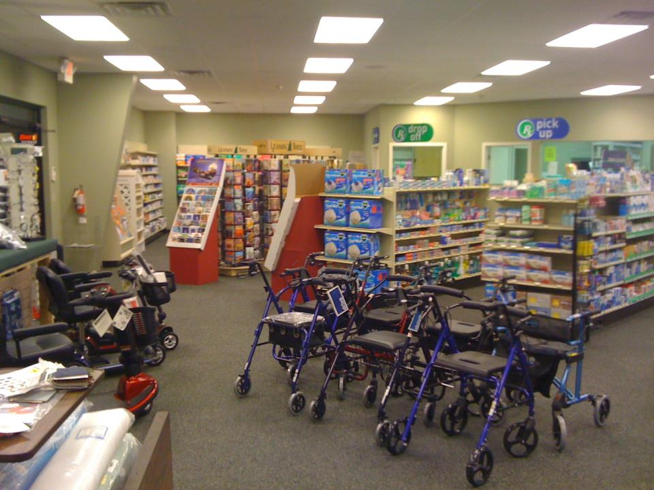
⬅Entrance

Slide 11
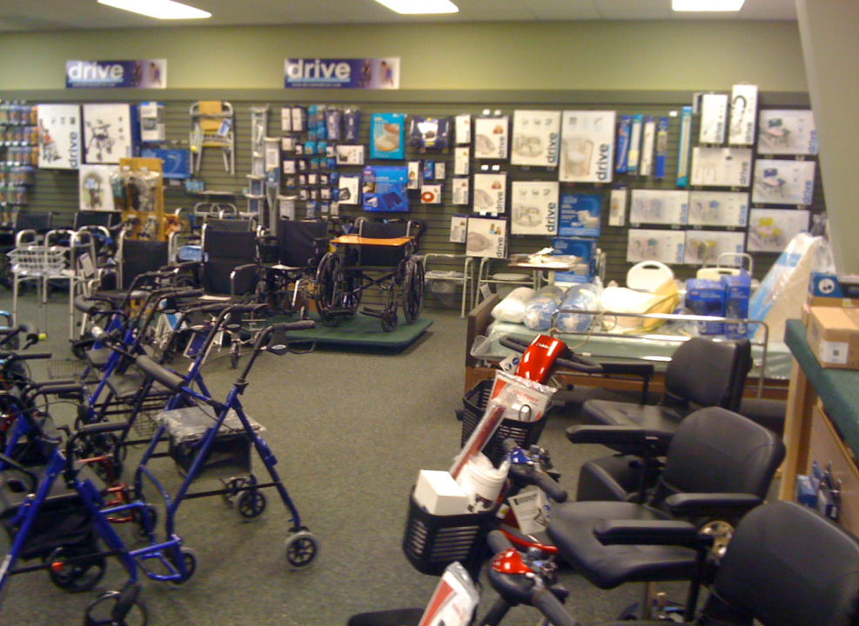
The HHC Rx

Slide 12
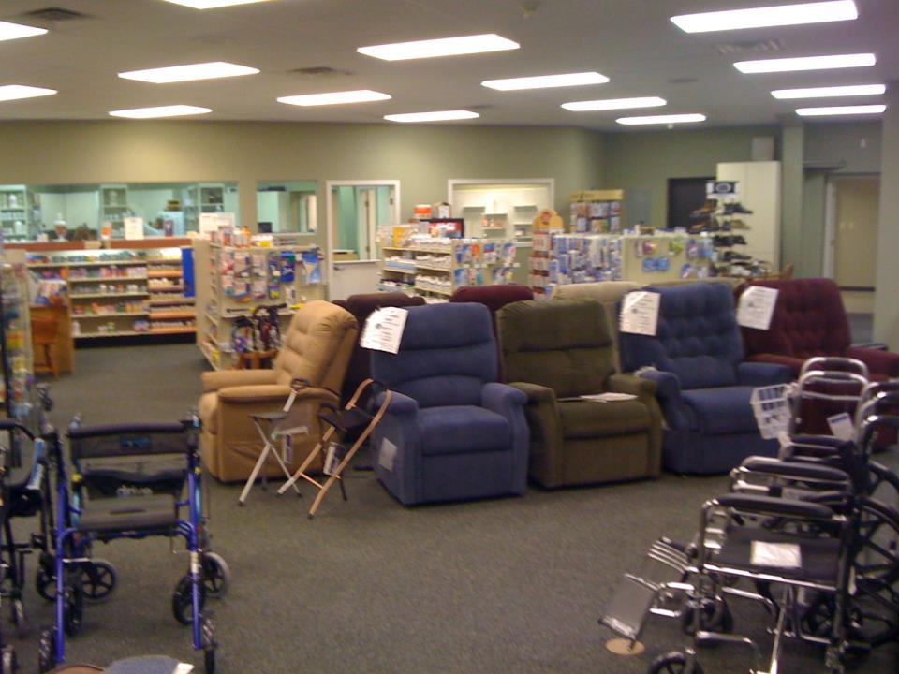

Slide 13
Retail HHC Best Practices:
Profits
Gross Profit Margin (GPM)
48 - 50 percent average
  Expensive and competitive products might only be 40 - 45 percent GPM
  Soft goods and generics are often 100 percent GPM
  Many HHC retailers use 2.3 as multiplier
Net Profits
8% - 12% (in relation to showroom size)
12% - 15% if fully automated
  POS, Inventory Scanner, Auto Reorder

Slide 14
Intake vs. Retail Sales
Traditional Intake
“What insurance do you have?”
Show reimbursable product
Process insurance
  Eligibility
  Intake
  Dr’s Rx
  Authorization
= 1 hr.
= 1 product/patient
Retail Sales
“Who is the end-user?
“What is their medical condition and need?”
Display all available products that meet their needs
Ask for insurance
Use ABN (w/upgraded code)
Cross-sell and up-sell
= 20 min.
= 2 products/customer
1 intake = 2 lost retail sales/hour = minus $300 - $400/hour!

Slide 15
Retail HHC Best Practices:
Merchandising #1
HHC is displayed in departments w/category signs and the minimum critical mass necessary to generate optimum sales:
  8 – 12 Lift Chairs • 6 - 8 Wheelchairs/ Transport
  4 – 6 Scooters Chairs
  8 – 12 Rollators • 2 Beds (Hospital + Adjustable)
  50 - 100 Designer Canes • 12’ Planograms for all Core Categories

Slide 16
Retail HHC Best Practices:
Merchandising #2
The more product displayed, the higher the sales and profits:
  2-3 Lift Chairs displayed = 1-2/mo. sold
  5-6 Lift Chairs displayed = 3-4/mo. sold
  10-12 Lift Chairs displayed = 8-12/mo.
  15 Lift Chairs displayed = 16-20/mo.
Inventory turns:
  8 – 9/year on average
  10 – 12/year for soft goods

Slide 17
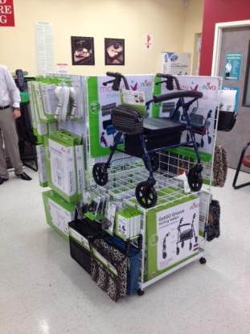
Rollator ROI
Turns/mo = #/floor
1-2 Display = 1/mo
2-3 Display = 3/mo
5-6 Display = 6/mo
10-12 Display = 12/mo
1 = 4 sq ft
Cost = $79
Retail = $149
GP = $70
Rent = $40
Net = $30
Fully Loaded:
GP = $150
Net = $110
➔ Accessorize 1 Core Product/Category!

Slide 18
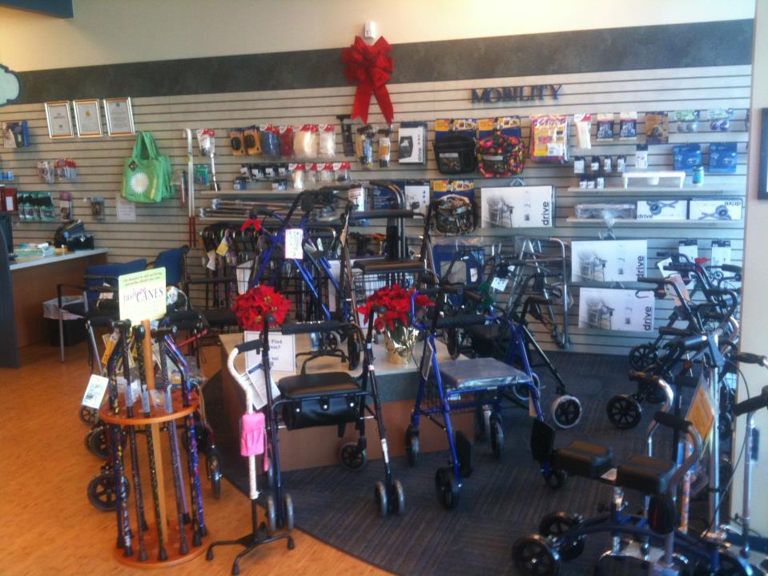

Slide 19
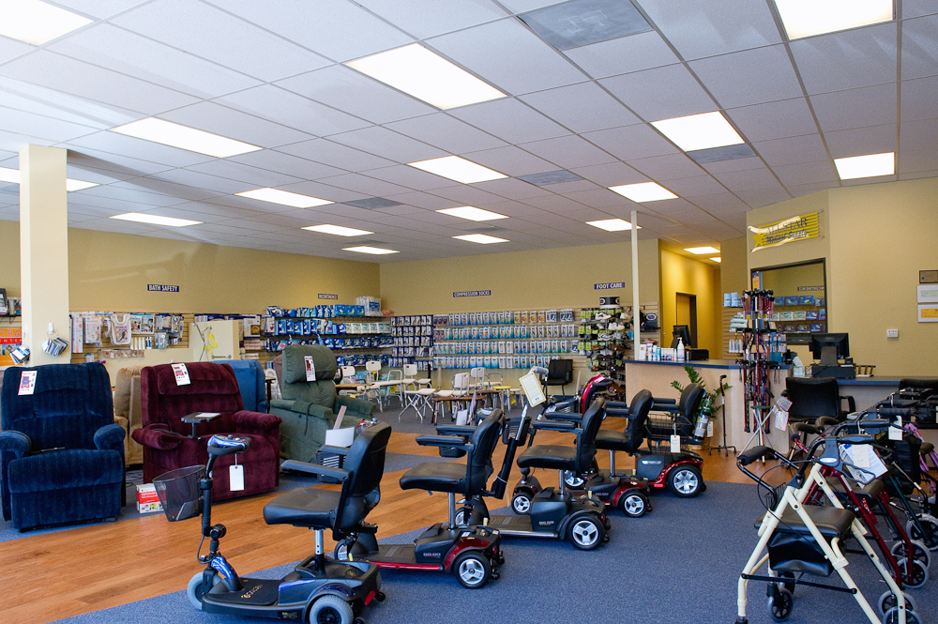

Slide 20
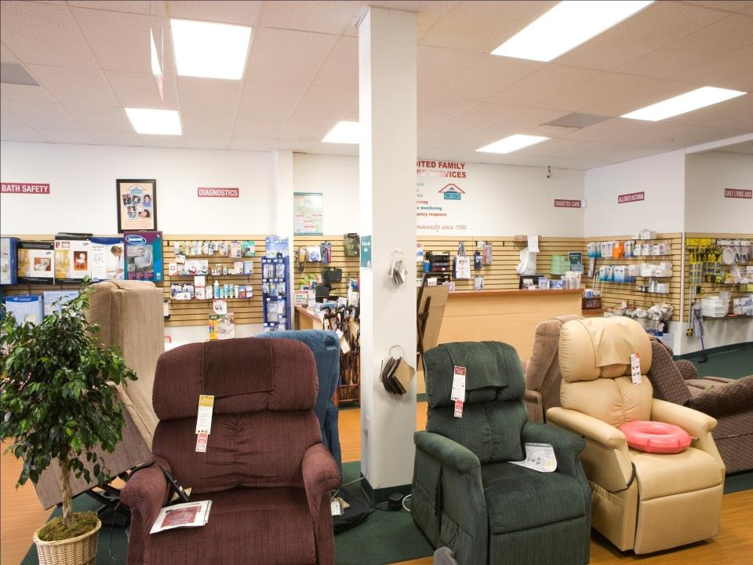
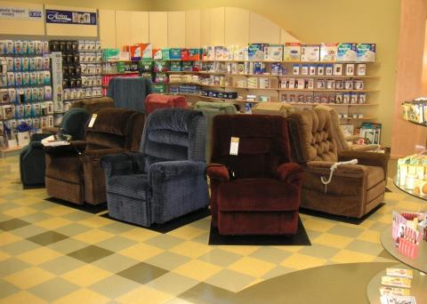

Slide 21
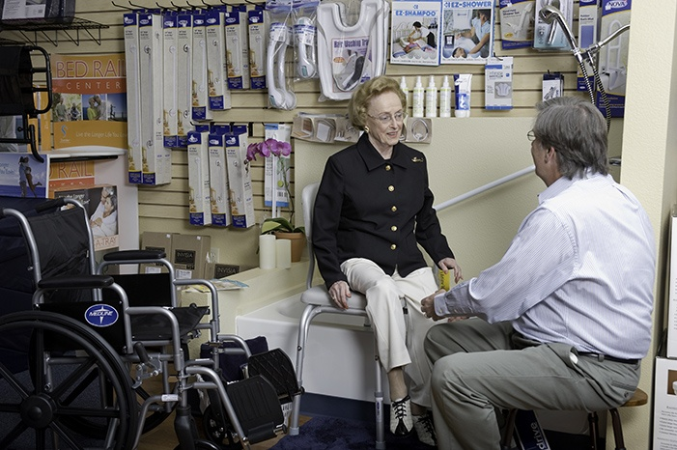

Slide 22
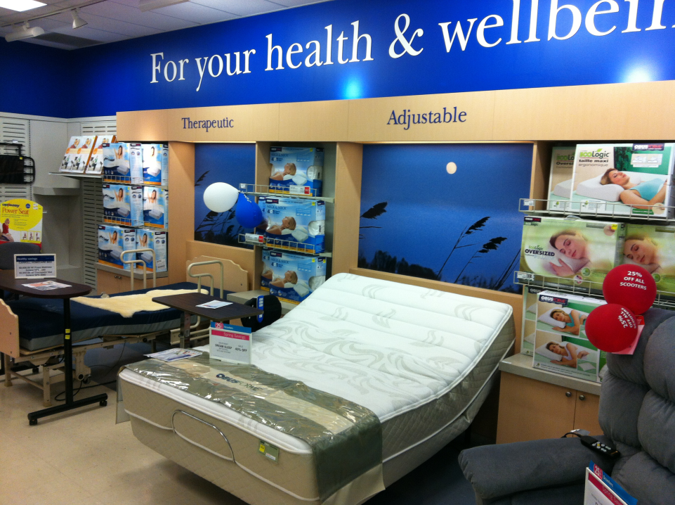
Does Your Hospital Bed Look Like This?

Slide 23
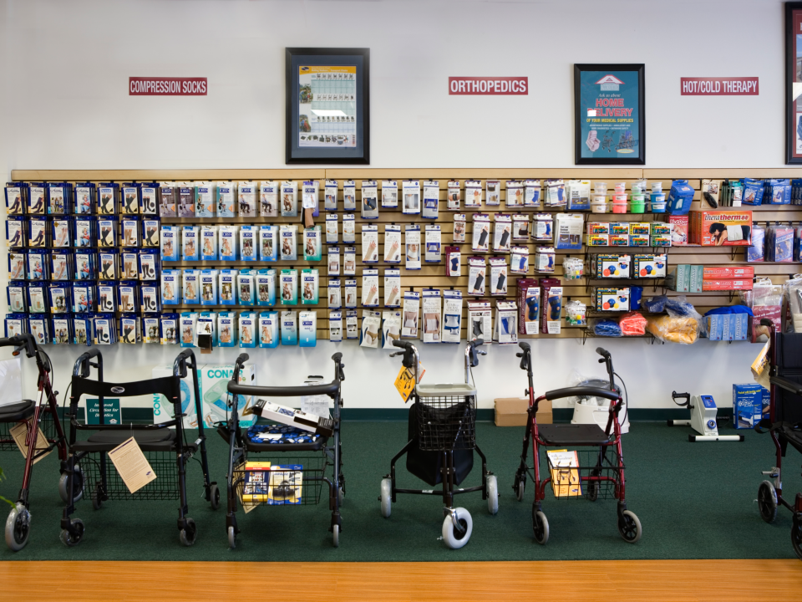

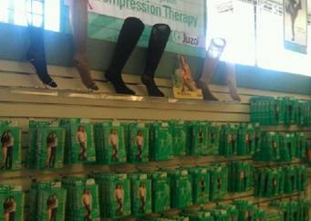

Slide 24
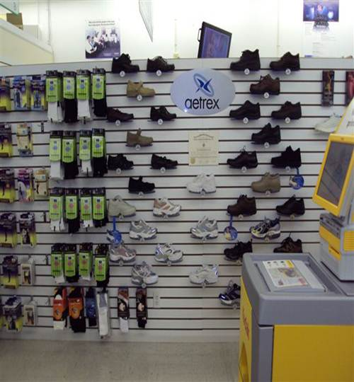

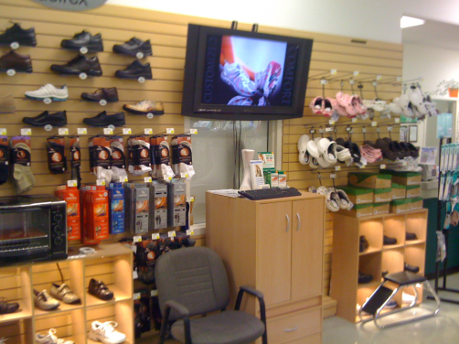
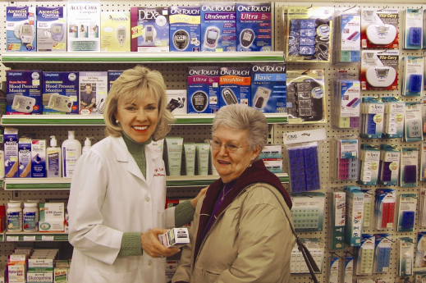

Slide 25
Outcome-Based HHC:
Take-Aways
Outcomes-Based Healthcare System Basics:
  Preventative vs. critical care
  Patient treatment plans (Dr., Health Plan, CMS)
  Healthcare professional to coordinate care
  Metrics to measure outcomes
Patient Wellness:
  Patient Education
  Patient Adherence
  Patient Compliance
Patient Care Coordinator:
  Monitoring on regular basis (i.e. monthly visits in-store)
  Payment per patient/disease state/mo.
  Annual risk-sharing monetary rewards

Slide 26
The Rx Transition:
Scripts
Wellness
Patient Care
Where are you?

Slide 27
Traditional Rx: Reactive
Pharmacist behind counter
Pill-counter
Scripts as profit center
OTC’s + impulse sales =
high sales/customer
➔ Life was good!

Slide 28
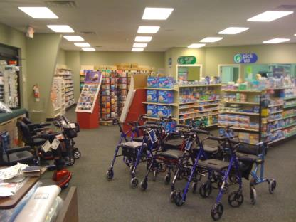
Current Rx:
Community Healthcare Center
Vitamins & Supplements
Compounding
Home Healthcare (HME)
Flu Shots & Immunizations
Weight Management Programs & Products
Smoking Cessation Programs & Products
➔ Dabbling w/o focus

Slide 29

Future Rx:
Preventative & Proactive
Patient Education
Medication Therapy Management (MTM)
(= Adherence)
Disease State Management (= Compliance)
Partner with
Accountable Care
Organizations (ACO’s) (= Patient Care)
➔ Patient Care Coordinator

Slide 30
Medication Adherence
Over 40% of patients do not take their medication as prescribed.
Of the 45% of N. Americans who have a chronic disease, 1/3 never fill their prescriptions.
Adherence alone would keep the majority of patients with chronic illnesses healthier and out of the ER and hospital.
Outcomes payments for quarterly med reviews.
Beyond pill boxes: “Smart” automatic medication management systems remind, dispense, alert, and post information on compliance and inventory.

Slide 31
Beyond Rx & HME:
The Patient Care Coordinator as Gatekeeper
End-user
Patient
Customer
Pharmacy
Rx
Chronic
Disease
Illness
Med Check
Disease
Management
In-store
Clinic
Synchronization
Consultation
Home Health
Care
Rx
Refill
Risk
Sharing
Disease
Management

Slide 32
Rx + Preventative Care = Positive Outcomes
Healthcare Screening
  High Blood Pressure
  Elevated Cholesterol
  Weight Analysis
  Heart Disease
  Diabetes
  Asthma
  COPD
Patient Monitoring
  Blood Pressure
  Blood Sugar
  Cholesterol
Immunizations
  Chicken Pox
  Flu
  Hepatitis A & B
  HPV
  Measles
  Pneumonia
  Polio
  Shingles
  Tetanus
  Travel
    Malaria
    Meningitis
    Typhoid
  Whooping Cough
MTM
  Quarterly Med Checks
  Patient Education
    One-on-one
    Classes
Disease Management
    Asthma
    Cancer
    Congestive Heart Failure
    COPD
    Diabetes
    High-risk Pregnancy
    Hypertension
    Obesity
    Sleep Apnea
Lifestyle Management
  Smoking Cessation
  Weight Management
  Exercise Program
HHC Showroom
  Medical Supplies
  Home Medical Products & Equipment
  Home Accessibility

Slide 33
5 Lifestyle Changes =
80% Reduction in Risk of Developing Type 2 Diabetes*
Maintain healthy diet
Exercise regularly
No smoking for at least 10 years
Moderate alcohol consumption
Maintain normal body weight (i.e. BMI 18.5-24.9)
*NIH-AARP study 2012

Slide 34
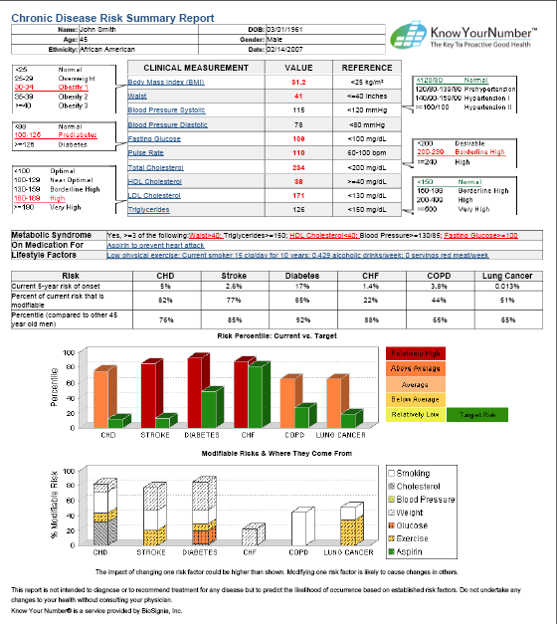

Slide 35
Two HHC Options for Patient Education Reimbursement
Medicare
Accountable Care Organizations (ACO’s)
= Health Systems
Independents can contract with even if only 1 location
Become Patient Care Coordinators for Hospital at Home programs
Paid for Education
Share in Risk (70%-80%)
3rd Party Payers
Different by Region
Need Multiple Locations (= Coverage)
Chain or join/create a Network of Independents
Join Medical Home team
Paid for Education
Share in Risk (20%-30%)

Slide 36
ACO Goals
Reduce healthcare costs by improving care
  Compared to current Medicare costs per patient/disease state/year
Improve beneficiaries health and outcomes
  Patient Education & Compliance
Coordinate patient care to eliminate duplication of services
Focus on preventative care
  Disease & Lifestyle Management Programs
Avoid high-cost services such as ER, unnecessary specialists, or hospital stays
Avoid restricting care via quality metrics as safeguards

Slide 37
Medicare: Hospital at Home
Care Team: Physician, HC Nurse, Rx, & HME
Monitor vital signs
Monitor medications
Manage pain
Dress wounds to avoid bed sores and infections
Conduct diagnostic tests to track recovery & monitor symptoms
Improve lifestyle via management programs
Assess home for safety and any HME needed
Care for the caregiver to avoid burn-out

Slide 38
3rd Party Insurance:
The Medical Home Model
Care Team: Physician, HC Nurse, Rx, & HME
LivingWell@Home (The Good Samaritan Society):
  Telehealth (Blood Glucose, Blood Pressure, Pulse Oximeter, Weight, ECG recorder)
  In-home Sensors (Motion, Temperature, Water Usage, Smoke)
  Personal Emergency Response Systems (PERS)
Cost: $6,000/person/year (= 1 mo./LTC)
Goals: To reduce high risk for re-hospitalization with patients discharged back home after hospital stay.
Outcomes:
  Reduce healthcare costs
  Reduce utilization of healthcare services
  Facilitate better outcomes for quality of life and personal satisfaction
  Support aging in home by delaying transfers to LTC’s

Slide 39
Establishing the HHC Value for Outcomes
= Patient Care Coordinator
Collect patient data
Educate patients (via disease management programs w/proven cost-savings)
Demonstrate services are cost-effective
Demonstrate services lead to better patient outcomes
Document a reduced number of patient hospital readmissions and ER visits
Charge per patient/disease state/mo. (i.e. $2/min. = $60/30 min. or $120/60 min.)
Share in annual savings per patient

Slide 40
Patient Coordinator’s Role*
Enhance care by using patient-specific data provided by 3rd party health plan
  ID patients being discharged who are at risk for readmission
  ID patient who are overdue for health screenings
  ID patients who have skipped Rx refills
  Contact these patients for:
    Follow-up care or screenings
    ID any medication issues
    Help prevent chronic conditions from worsening
*Cigna’s Patient Centered Initiatives

Slide 41
Patient Coordinator’s Role (cont.)
Provide disease management education (or)
Refer patients to 3rd party insurance companies for clinical disease management programs…
  Diabetes
  Heart disease
  Asthma
…and lifestyle management programs
  Weight management
  Tobacco cessation
  Stress management

